Slide 1
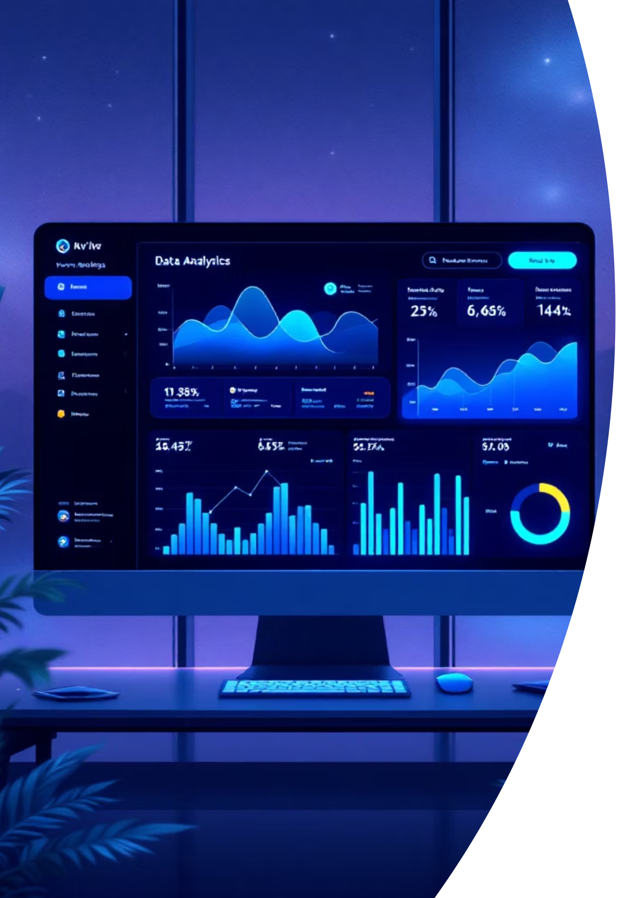

Sales Intelligence & Decision Engine
Transforming CRM data into actionable insights to diagnose win rate decline and prioritize high-value revenue opportunities.
SHAJJAD SHAIKH
DATA SCIENCE / APPLIED AI

Slide 2

Strategic Overview
The Challenge
Moving beyond standard reporting to create a diagnostic framework that identifies funnel leaks and revenue sweet spots. The system pinpoints where the sales funnel is "leaky" and which segments offer the highest recovery potential.
Established baseline: 45.3% organizational win rate with confirmed sustained performance decline requiring immediate intervention.

Slide 3
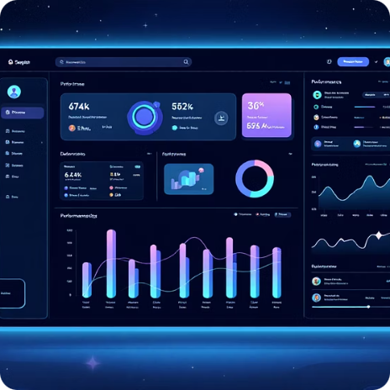

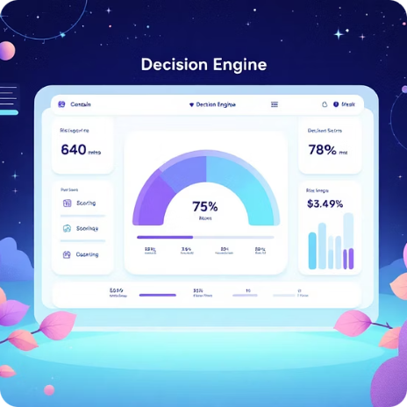

Key Deliverables
Performance Baseline
Custom Metrics
Decision Engine
Productized Alerting
High-Value Win Rate (46.4%) and Segment Driver Score to protect strategic revenue.
Rule-based system scoring deals into Low, Medium, High-Risk bands by segment probability.
Automated flags for stalled deals 15+ days beyond median sales cycle.
Established 45.3% win rate and confirmed sustained trend requiring intervention.

Slide 4
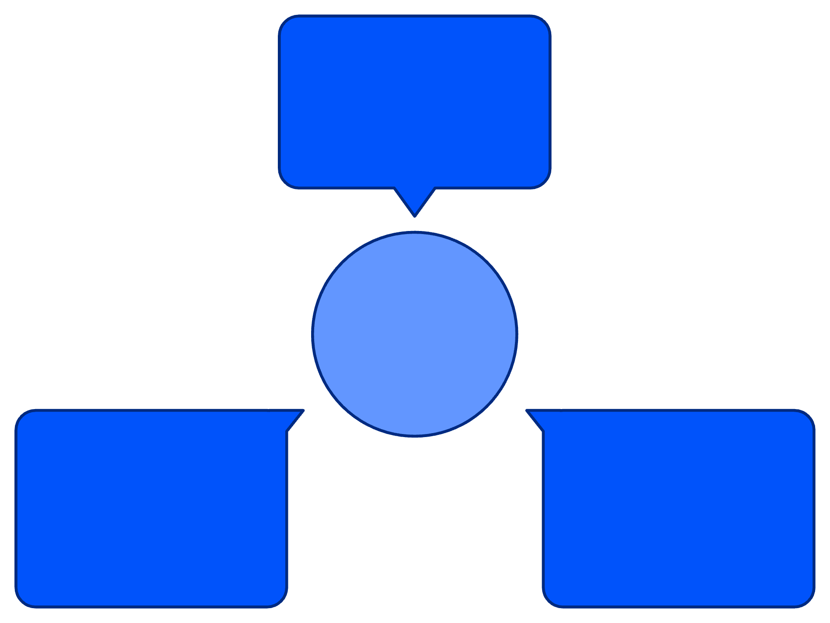
Problem Framing
Declining segments
Which segments show falling win rates
The Real Issue
Funnel leakage where healthy pipeline volume masks late-stage execution failures. Leadership lacks visibility to distinguish high-probability "sweet spot" deals from high-risk "stalled" deals.
Diagnose Pipeline Health
Core Assumptions
High-risk signals
CRM data is reliable and consistent
Internal sales process remained stable
External macro-factors not explicitly modeled
Funnel leakage
Indicators of troubled opportunities
Where deals drop through stages
The system addresses three critical diagnostic questions to transform pipeline visibility.

Slide 5
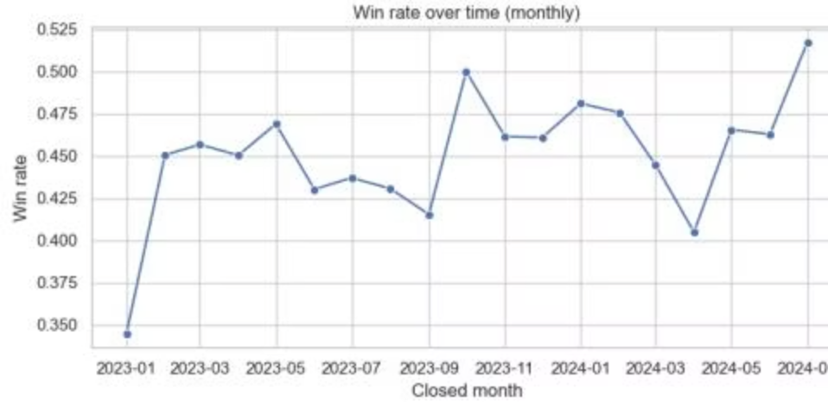

Win Rate Trends: Sustained Decline Confirmed
Monthly Win Rate Analysis
Tracks the share of Won deals closed each calendar month, distinguishing between short-term blips and sustained decline.
The trend reveals consistent underperformance requiring strategic intervention, not just tactical adjustments.

Slide 6
Critical Insights: Where We're Losing
Late-Stage Bottlenecks
Industry Sweet Spots
Lead Source Efficiency
Win rates drop during Proposal and Qualified stages. Problem is execution (pricing pressure, lack of champions), not top-of-funnel fit.
FinTech and SaaS run above baseline, while other sectors lag. Strong product-market fit indicates safest bets for growth.
Inbound and Referral show clear win-rate lift over Partner and Outbound channels.
Action: Tighten qualification for low-performers, reallocate budget to Inbound.
Action: Mandatory late-stage deal reviews and pricing guardrails.
Action: Shift marketing spend and SDR focus to high-win industries.

Slide 7
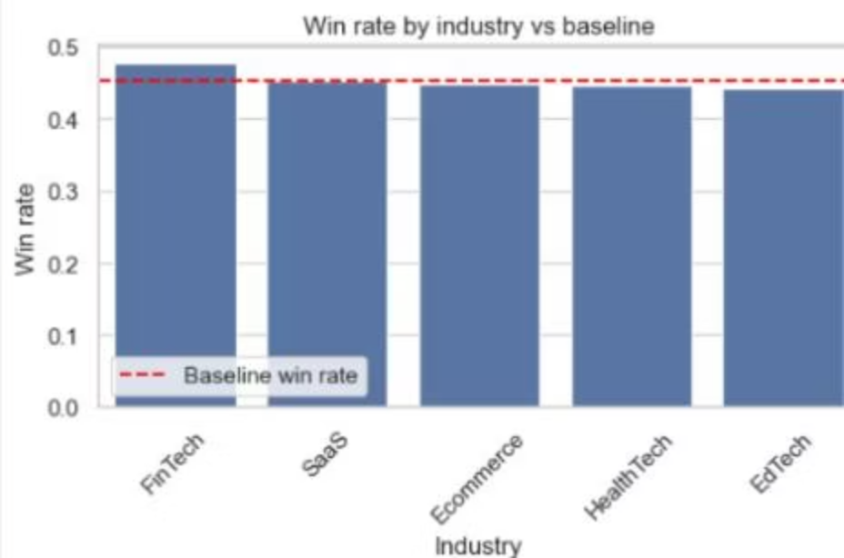
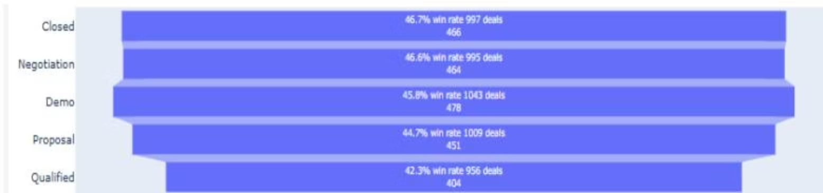
Performance by Stage & Industry
Closed and Negotiation stages perform best (46.7%, 46.6%), while Qualified lags at 42.3%. FinTech leads industries at ~48%, with HealthTech and EdTech underperforming at ~42% and ~41%.

Slide 8
Win Rate Decision Engine
Premier Segment Identified
61%
+16
FinTech Sweet Spot
Above Baseline
North America / Inbound leads
Percentage points advantage
Rule-Based Risk Banding
Interpretable engine mapping historical segment performance to current open deals for immediate action.
Low Risk / High Fit
Medium Risk
High Risk / Low Fit
≥60% win probability. "Sweet Spot" deals follow standard closing playbooks.
45-60% probability. Monitor closely, review rep alignment.
<45% probability. Leaky segment requires immediate manager review.

Slide 9
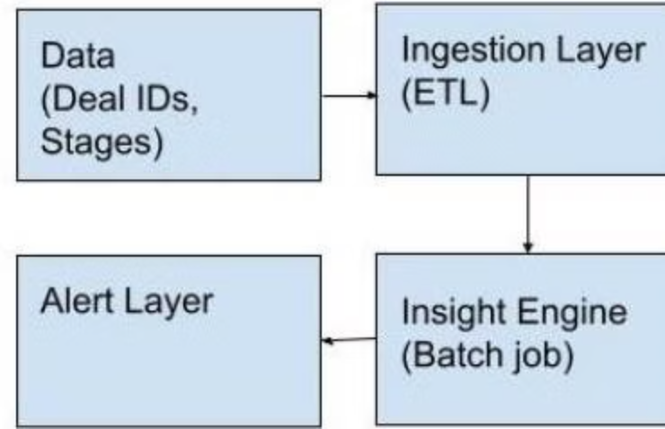

System Architecture: SkyGeni Product Vision
Lightweight, Automated Intelligence
01
Ingestion
Daily ETL pulls raw deals, stages, outcomes from CRM to analytics warehouse.
02
Insight Engine
Batch job re-computes Driver Scores and Risk Bands every 24 hours.
03
Alert Layer
Structured insights converted to Slack/Email notifications for morning huddles.
Runs overnight to ensure fresh data for daily sales operations.

Slide 10
Roadmap & Critical Considerations
Data Hardening
1
Implement automated validation and minimum volume thresholds to suppress alerts from sparse segments.
2
Productization
Transition from notebooks to scheduled service (Airflow) with CRM-embedded dashboard.
Feedback Loop
3
Enable sales leaders to up-vote/down-vote alerts, automatically tuning thresholds for improved accuracy.
Key Risks & Mitigation
Weakest Assumptions
Production Breaking Points
Historical win-rate patterns may not remain stable. Macro shifts or competitor moves can quickly render segment averages obsolete.
Schema instability and sparse segments with low deal volumes create noisy probabilities. Requires enterprise-grade access control.

